Slide 1

Question
What are the main types of employee motivation? Explain with examples.
Presented By:
Mahmudul Hasan Shihan
ID: 2221081098
Presented To:
Rashed Mahmud Shakil
Assistant Professor

Slide 2

Types of Motivation
Achievement Motivation
Affiliation Motivation
Competence Motivation
Power Motivation

Slide 3
Types of Motivation
Attitude Motivation
Incentive Motivation
Fear Motivation

Slide 4

Question
What does Organizational Behavior mean,
and how does it contribute to improving organizational performance?
Presented By:
Abdur Razzak
ID: 2221081081
Presented To:
Rashed Mahmud Shakil
Assistant Professor

Slide 5
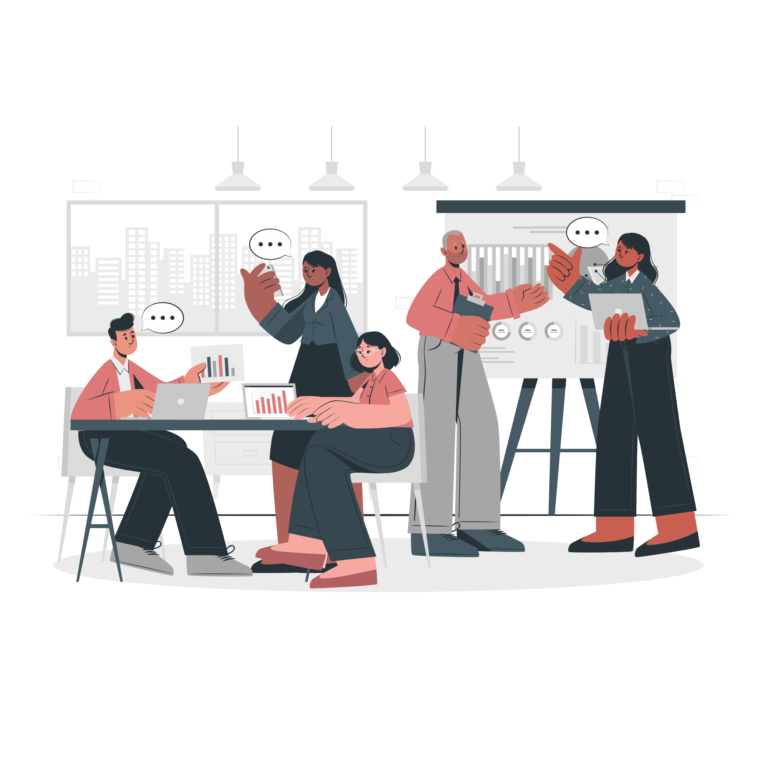
Organizational Behavior
Organizational Behavior (OB) is the study of how individuals, groups, and structures interact within an organization.
It helps in understanding, predicting, and influencing human behavior to enhance organizational effectiveness .

Slide 6



Key Aspects of OB
Individual Behavior
Focuses on personality, motivation, perception, and attitudes that influence work performance.
Group Dynamics
Studies teamwork, communication, leadership, and conflict resolution within groups
Organizational Structure and Processes
Examines how company policies, leadership styles, and culture impact behavior.

Slide 7

How OB Improves Organizational Performance
Enhances Employee Motivation & Productivity
Motivated employees work more efficiently, increasing overall performance.
Improves Teamwork & Communication
Strong communication reduces misunderstandings and enhances collaboration.
Enhances Job Satisfaction
A better understanding of employee needs leads to a more engaging work environment.
Encourages Innovation and Creativity
By understanding team dynamics, OB helps create an environment that fosters innovation.

Slide 8
Question
Illustrate various characteristics which are held by the motivation.
Presented By:
Nusrat Tabassum Nabila
ID: 2221081098
Presented To:
Rashed Mahmud Shakil
Assistant Professor

Slide 9
Human Aspect
Motivation focuses on stimulating human actions to achieve desired results, creating a willingness to work.
Psychological Concept
It arises from internal feelings of unmet needs, influencing behavior and actions.
Need-Satisfying Activity
Motivation drives individuals to work by fulfilling their personal and professional needs.

Slide 10
Motivation is Total, Not Part
A worker’s motivation is holistic, considering all interrelated needs and aspirations.
Financial and Non-Financial
Motivation can be financial (wages, bonuses) or non-financial (recognition, responsibility).
Constant Process
Motivation is continuous, as human needs evolve endlessly, requiring ongoing efforts.

Slide 11
Question
What is group dynamics, and why is it important in organizational behavior?
Presented By:
Jobaer Islam
ID: 2221081010
Presented To:
Rashed Mahmud Shakil
Assistant Professor

Slide 12
Group Dynamics
Group dynamics refers to the patterns of interaction that occur within a group involved in achieving a common goal. It studies how group members interact, influence each other, and collaborate to fulfill tasks.

Slide 13
Importance of OB
Enhanced Decision-Making
Diverse groups bring varied perspectives, which contribute to more innovative and effective decision-making.
Improved Problem Solving
Effective group dynamics foster an environment where members feel safe to express ideas, leading to creative solutions to complex problems.
Increased Productivity
Positive interactions among group members streamline processes and enhance productivity.

Slide 14

Question
Summarize various tools and techniques used by organizations to motivate people.
Presented By:
Nure Alam Akand Shadin
ID: 2221081095
Presented To:
Rashed Mahmud Shakil
Assistant Professor

Slide 15

What is Motivation?
Motivation is an important technique that is used by management. The management motivates the workforce for getting the work done from them.

Slide 16
There are several motives in the form of incentives.
Financial Incentive
Non-Financial Incentive
Incentives provided to employees act as stimulants and also induce certain actions and Behaviour from employees. Money has an important role in motivating people to do their work. Money satisfies the physiological and social needs of people and provides security to many people. Money is used in many different ways, which include wages, bonuses, salaries, perks, medical benefits, retirement benefits and more.
Non-financial incentives can be put into the following categories:
1. Work Appreciation
2. Healthy Competition
3. Group Incentive
4. Participation of Workers
5. Growth Opportunity
6. Job Enrichment

Slide 17
There are 6 catagories of Non-Financial Incentives
Job Appreciation
Healthy Compitition
Group Incentive
Appreciation of the work done by an individual is a big motivator. People being praised at work in school or university or at home works as a big morale booster and is an effective non-financial incentive.
Healthy competition in the workforce inspires them to put in their best efforts to achieve their
personal or group goals. Hence, competition acts as an important non-financial incentive for
employees.
Group incentive helps to boost and steer the team to perform better. It is more effective than individual incentives to motivate employees. It helps to improve team spirit among employees and makes the group work together as a team.
Participation of Workers
Growth Opportunity
Job Enrichment
When the management of the organization invites workers to take part in decision making, it creates an impact on them and motivates them. Workers feel important that they are being heard by the management which is a good motivating tool.
When employees are given growth opportunities for their career advancement, they feel satisfied and become more committed to their work and goals.
Job enrichment leads to more responsibilities, better scope and more challenges.Job enrichment motivates people by giving them more incentives, which act as
motivation for them to put in more effort for the accomplishment of their goals.

